Slide 1
Speech Authentication for Mobile Devices
Joseph Carluccio

Slide 2
OBJECTIVES
OUR AIM
Create a voice authentication system that allows users to either enroll or authenticate. This will be implemented with a GUI so that it can easily be integrated with other applications that require a password. Once recording, it will return the username and any other pertinent data of any authenticated users.

Slide 3
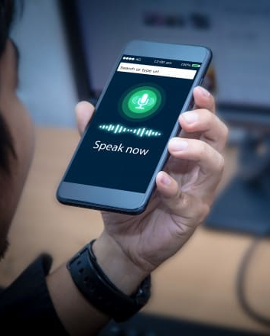
Applications
Have you ever tried to unlock ur phone to use siri or set an alarm with your hands full?
This would allow the user to unlock their mobile device or any other apps that require a password
Cater user experience for applications based on the actual user
Use voice authentication to recognize the user and cater things like search results or settings based on the user’s profile

Slide 4
What will be used?
SpeechRecognition
ChatGPT
Tkinter
A pre-existing python library that supports several engines and APIs, like Google Speech Recognition, Google Cloud Speech API, Microsoft Bing Voice Recognition, etc.
To aid in structuring and debugging the code
To create the GUI that allows the user to select enroll or authenticate
Pocketsphinx
Pickle
Matplotlib
The actual speech recognition engine - an open-source speech recognition system developed by Carnegie Mellon University
To store users’ voice prints in a database in a serialized format.
To visualize the performance data for the user to see

Slide 5
Design
Voice Recording:
Feature Extraction:
Database Access and Querying:
Record users' voices using microphone.
Convert the voice recordings into a standardized format, such as WAV or FLAC
Extract relevant voice features from the recordings
Implement functions to insert new user voice features into the database during enrollment and retrieve stored features during authentication.
Matching Algorithm:
User Enrollment Process:
Authentication Process:
Develop or utilize a voice matching algorithm to compare the features extracted from the user's voice during authentication with the stored voice features in the database.
record the user's voice, extract features, and store them in the database along with a unique identifier for the user.
record the user's voice, extract features, compare with stored features in the database. If they are similar enough,authenticate the user.
Notes:
Voice Recording:
Record users' voices using a microphone or a mobile device.
Convert the voice recordings into a standardized format, such as WAV or FLAC, to maintain consistency.
Voice Feature Extraction:
Extract relevant voice features from the recordings. Common techniques include Mel-Frequency Cepstral Coefficients (MFCCs), spectrogram analysis, or deep learning-based embeddings.
Extracted features should represent unique characteristics of the user's voice.
Database Management System:
Choose a suitable database management system (DBMS) to store the voice features. Options include relational databases (like MySQL or PostgreSQL), NoSQL databases (such as MongoDB or Cassandra), or specialized databases designed for audio data.
Database Schema:
Design an appropriate database schema to store user voice features. Create a table or collection with fields to store user identifiers (such as username or user ID) and their corresponding voice features.
Consider indexing the user identifiers for faster retrieval.
Data Encryption (Optional):
Implement encryption techniques to secure the stored voice features, especially if the database contains sensitive information. Encryption adds an extra layer of security to the stored data.
Matching Algorithm:
Develop or utilize a voice matching algorithm (such as Dynamic Time Warping or deep learning models) to compare the features extracted from the user's voice during authentication with the stored voice features in the database.
Define a matching threshold to determine the similarity level required for authentication.
Database Access and Querying:
Implement functions or APIs to insert new user voice features into the database during enrollment and retrieve stored features during authentication.
Optimize database queries for efficient matching, especially if the database grows large.
User Enrollment Process:
During user enrollment, record the user's voice, extract features, and store them in the database along with a unique identifier for the user.
Authentication Process:
During authentication, record the user's voice, extract features, and compare them with the stored features in the database using the matching algorithm.
If the similarity score meets the predefined threshold, authenticate the user; otherwise, deny access.

Slide 6
Measuring Success
FAR
FRR
a lower False Acceptance Rate (FAR) compared to existing fingerprint or face matching systems. This would indicate superior performance compared to those systems, deeming the speech authentication system successful.
Having a lower FRR compared to fingerprint or face matching systems. Heightened sensitivity to genuine user identities, aiming to minimize instances where valid users are incorrectly denied access. convenience

Slide 7
THANK YOU!
THANK YOU!

